Slide 1



AWS Website Hosting
DEC 01,2020
Group 2: Yunyun Jiang Malikat Coulibaly

Slide 2



AWS S3
Project Objective Review
It is for simple static website hosting, serverless
AWS Lightsail
It is for deploying simple website hosting using WordPress, Joomla, Moodle and other.
Amazon S3 , Amazon Lightsail, AWS Amplify Console
AWS Amplify
It lets you create Single-Page Applications (SPAs) and allows dynamic interaction with users

Slide 3

Efficiency
1.9 Billion
COMPLEXITY OF THE PROCESS
Evaluation Criterion
Cost
1.9 Billion
THE SERVICE CHARGE
Overall Performance
1.9 Billion
APPEARANCE AND UTILITY

Slide 4
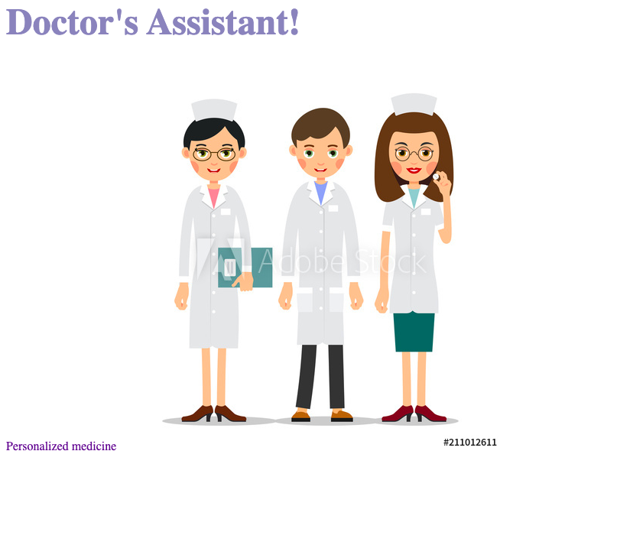
Index.html

Slide 5




Step 1
CREATE S3 BUCKETS
AWS S3
Step 2
UPLOAD WEBSITE PAGE
What are your next steps and goals? How much support do you need from investors and what will it get you?
Step 3
CHANGE BUCKET POLICY FOR PUBLIC ACCESS FOR DOMAIN BUCKET
Step 4
DNS CONFIGURATION

Slide 6
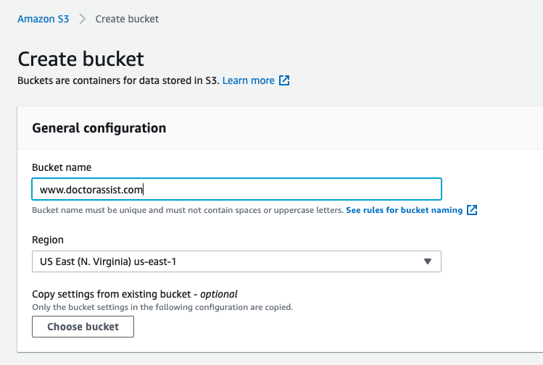
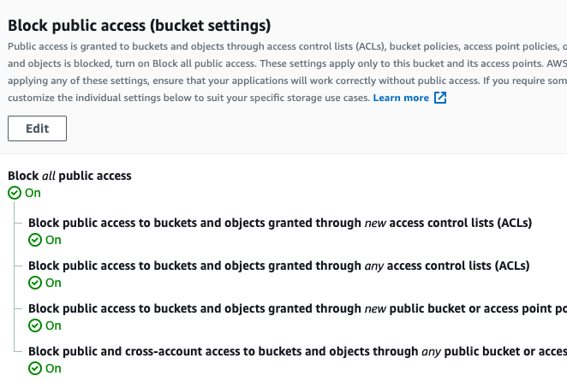
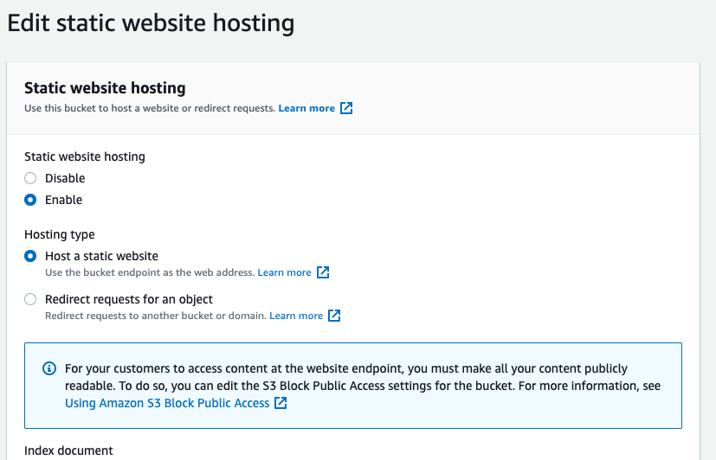
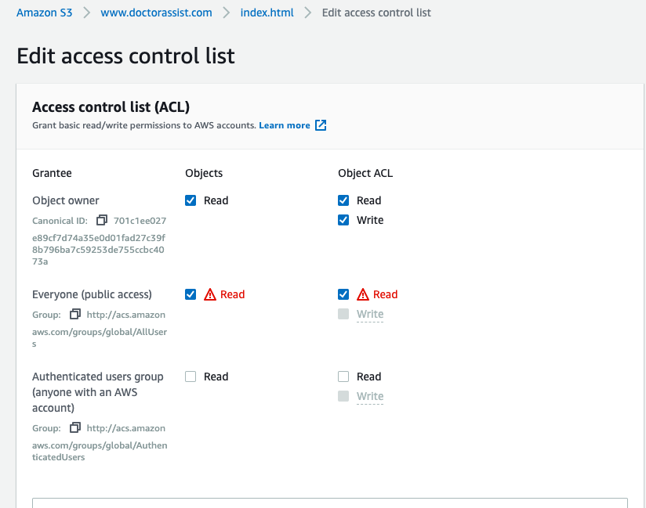

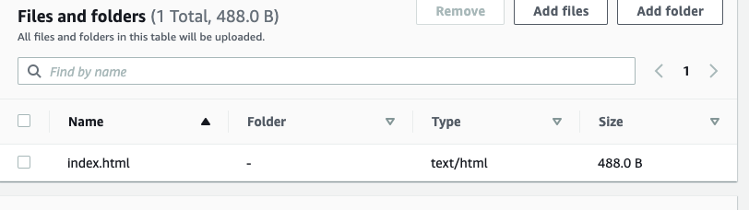

Slide 7




Simple
Summary of AWS S3
Time spend: 10 minutes
Cost: pay as needed
Performance: fair
Next steps
PITCH DECK V 1.0

Slide 8

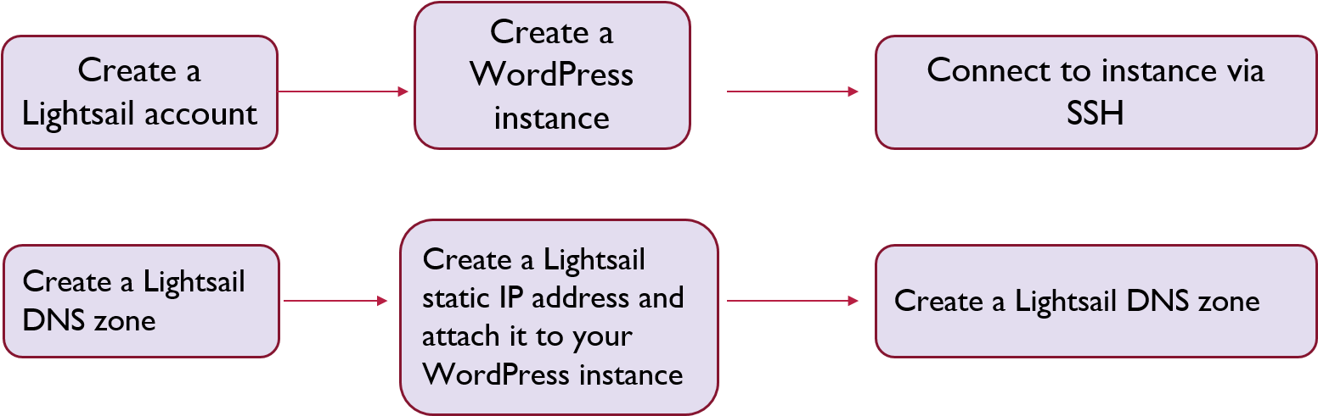
AWS Lightsail
With WordPress

Slide 9
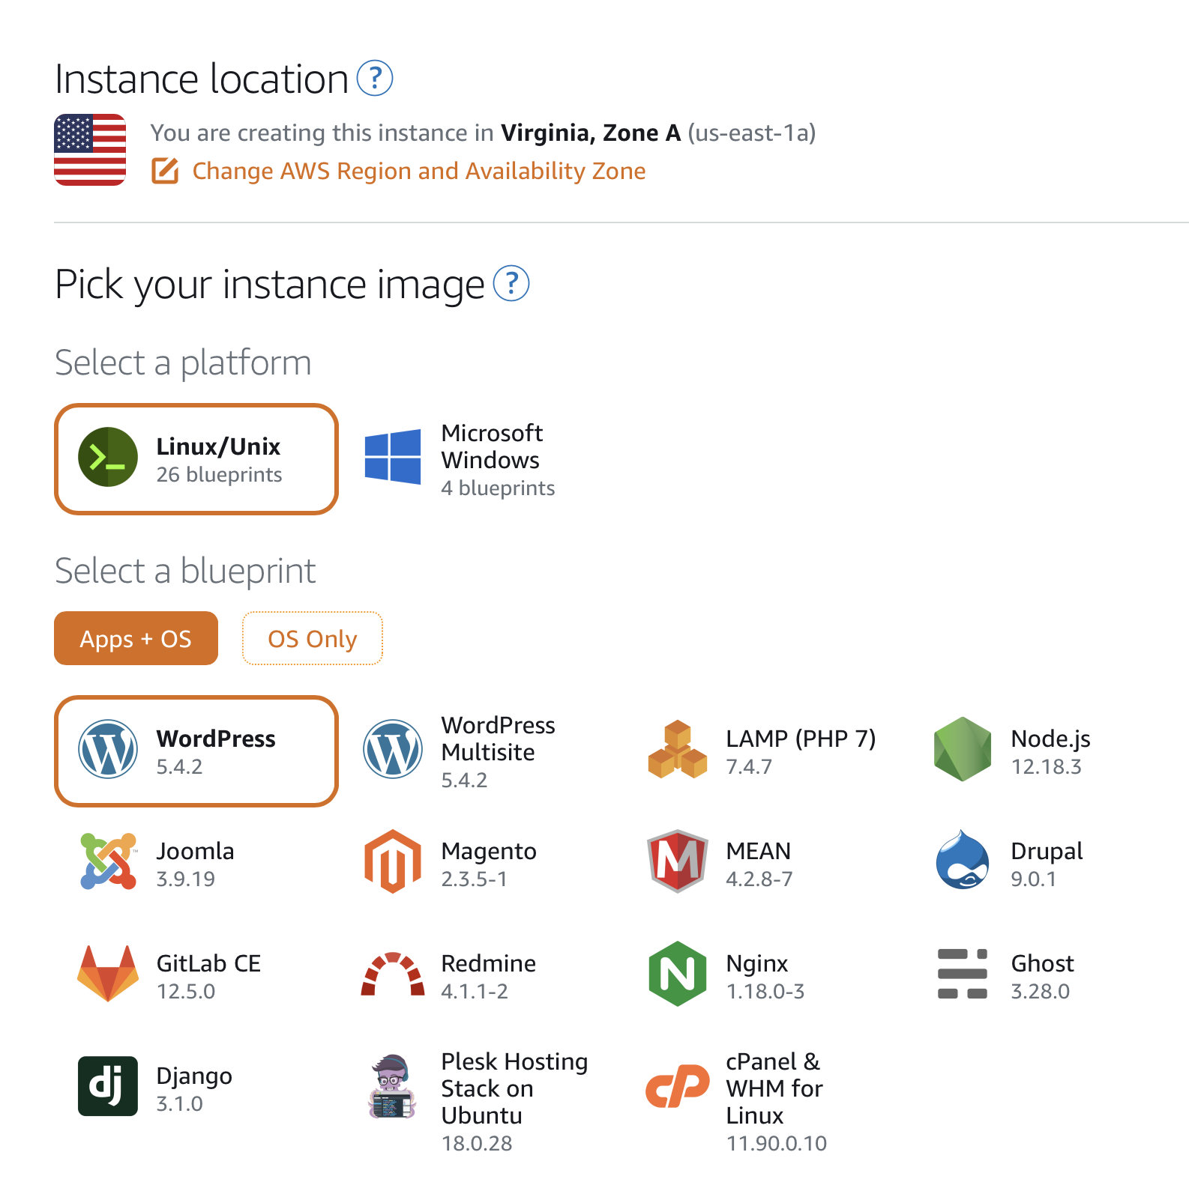
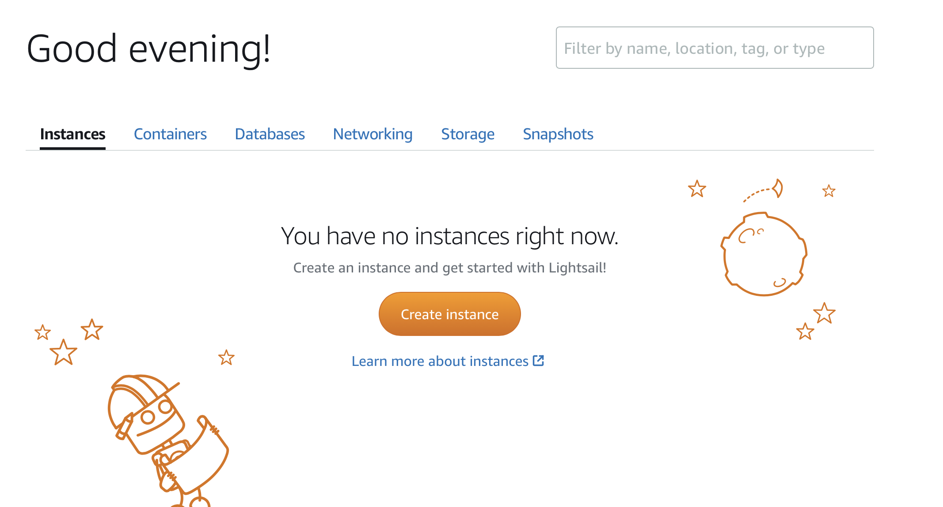
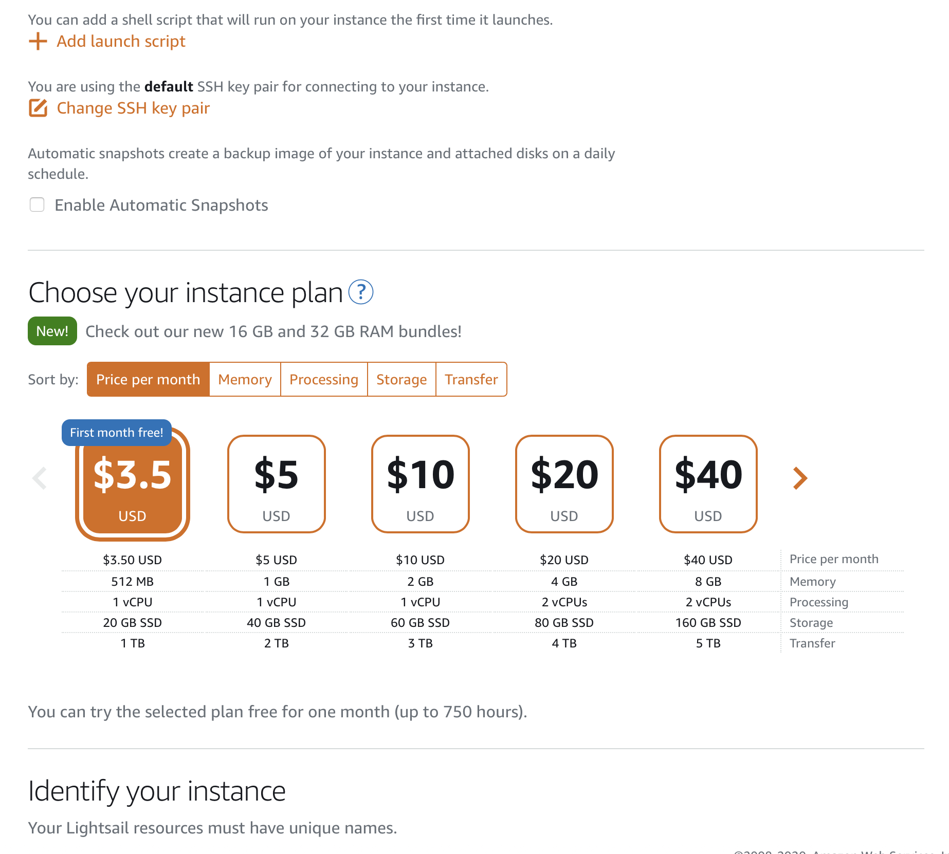
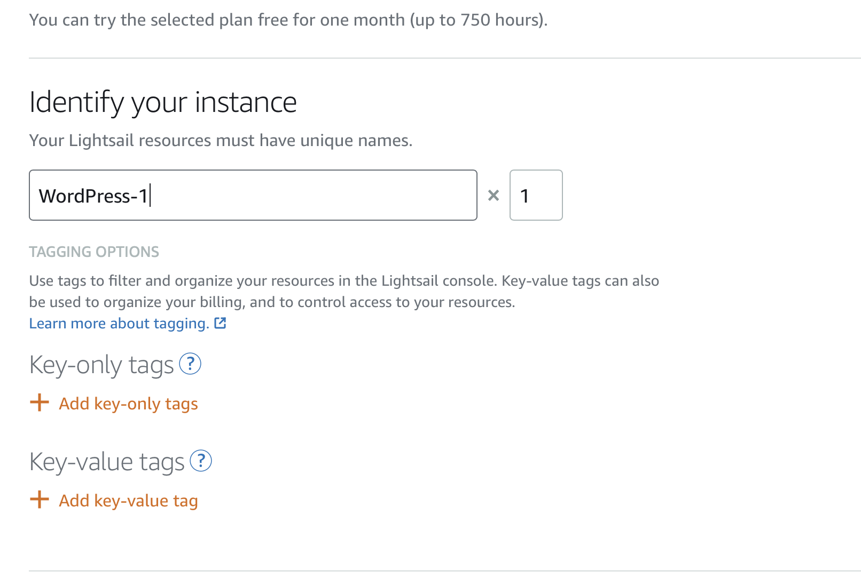
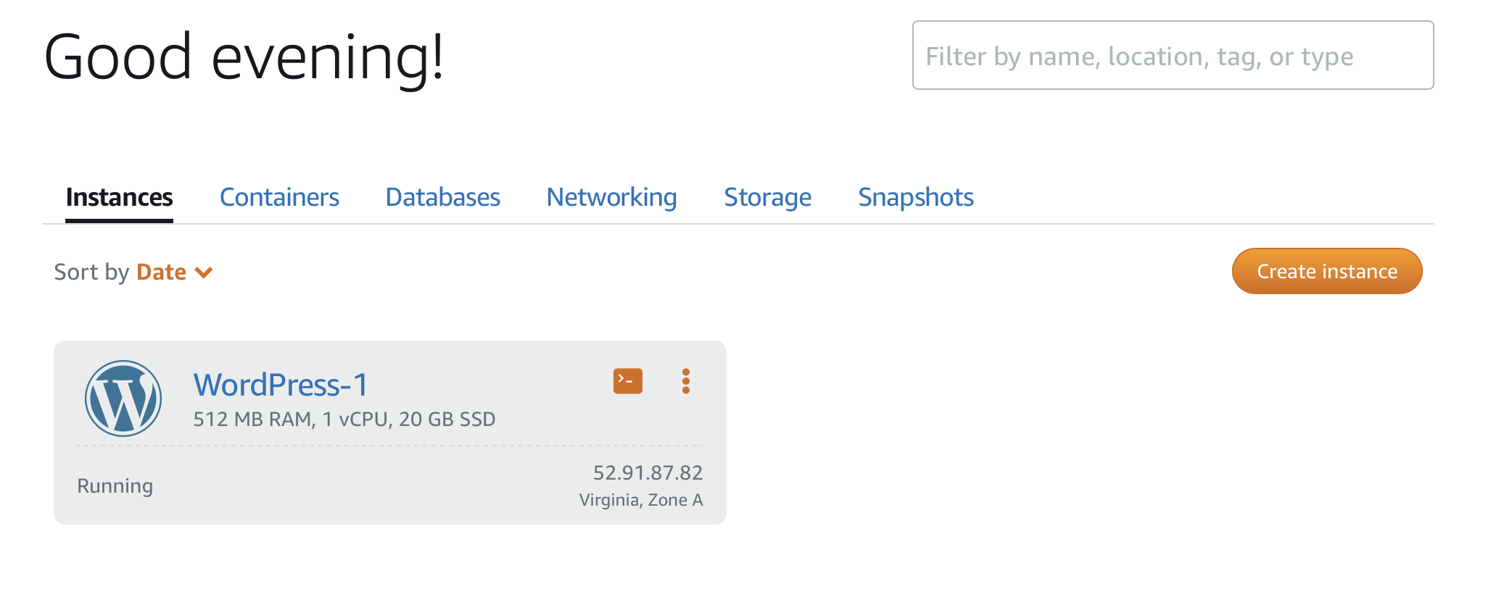
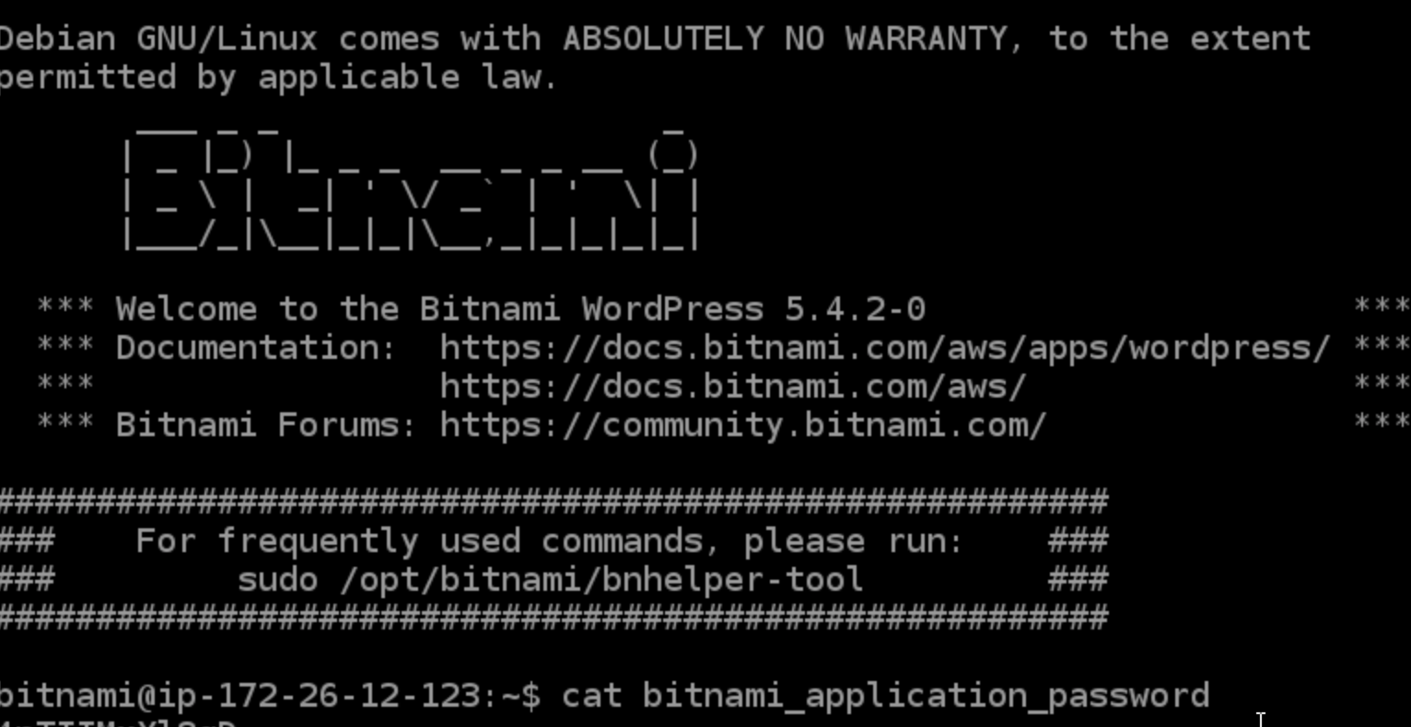

Slide 10
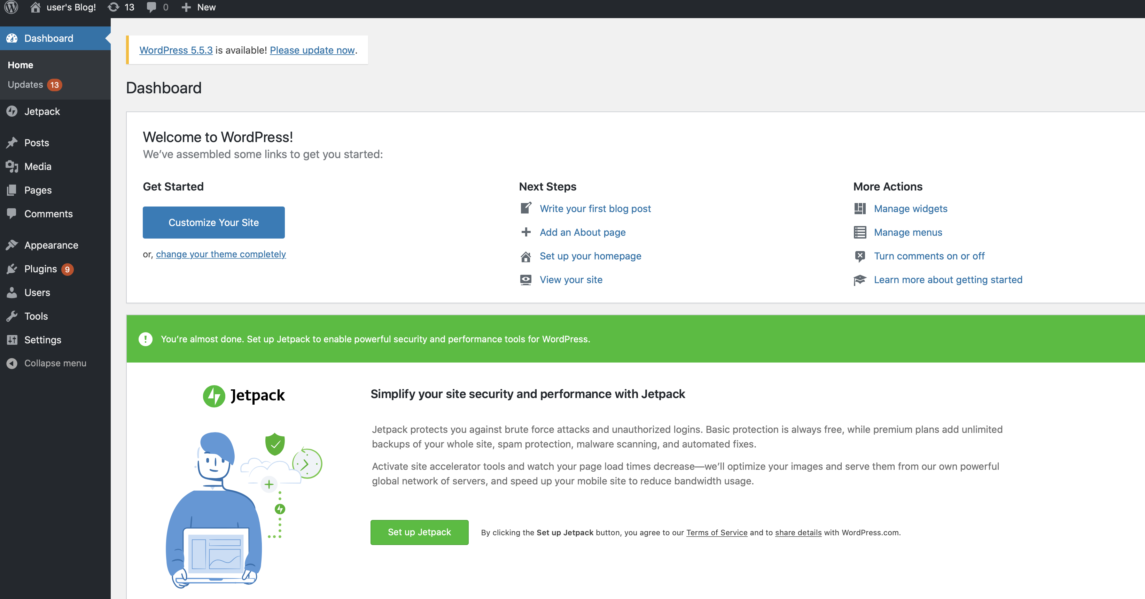
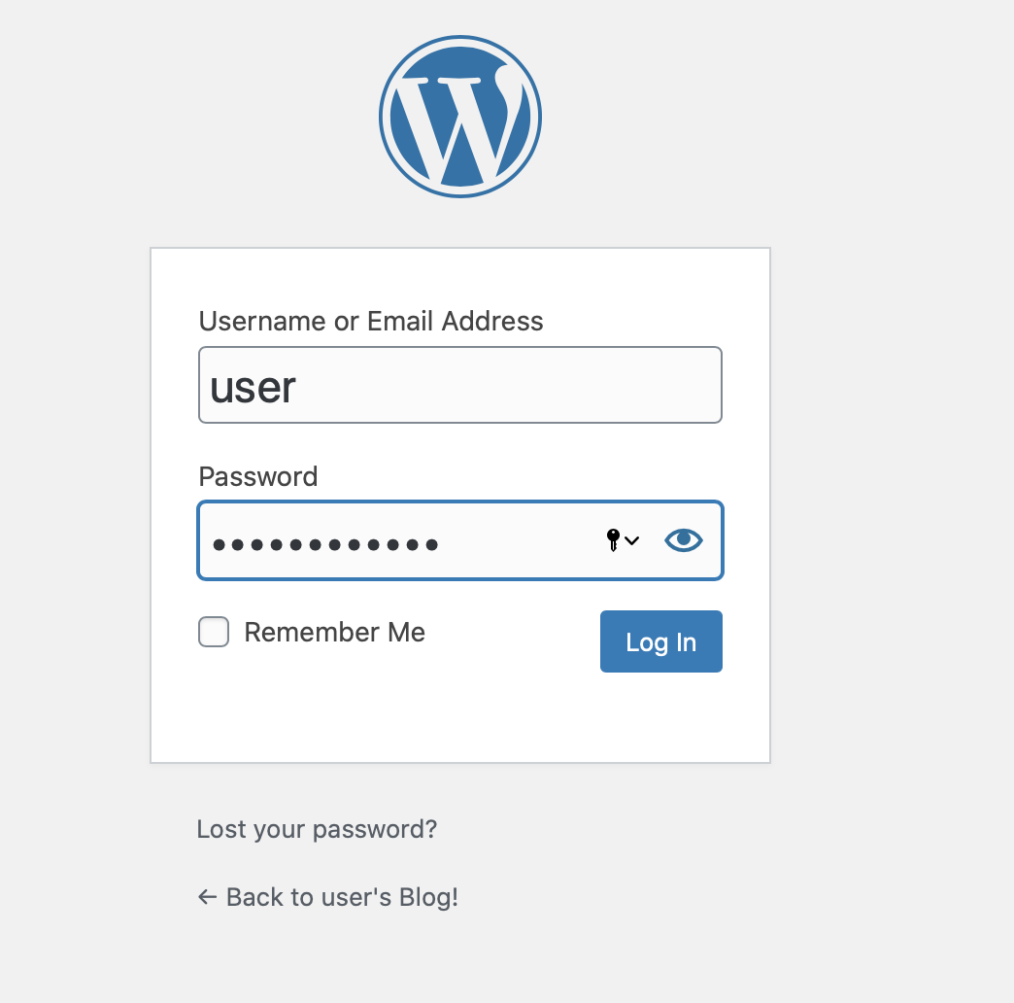


Slide 11


Level of complexity
Median
Summary of LightSail
Time spent
PITCH DECK V 1.0
30 minutes
Cost
3-4 dollars at start
Performance
Good

Slide 12
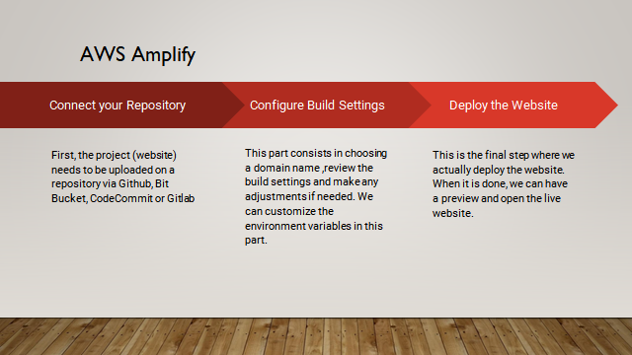

Slide 13
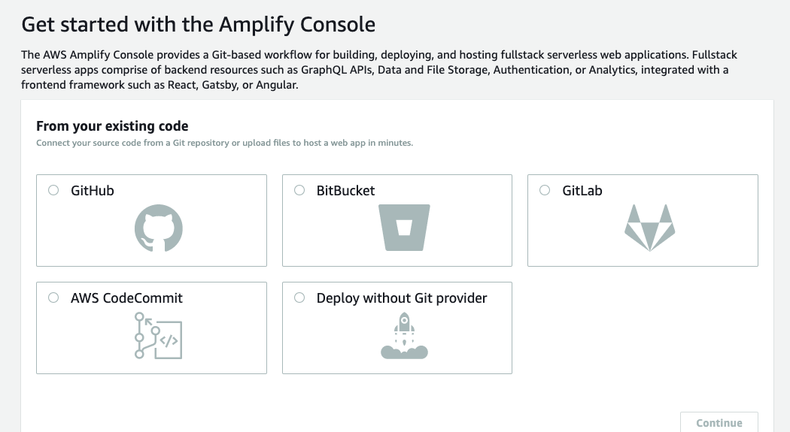
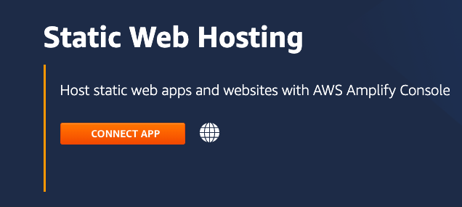
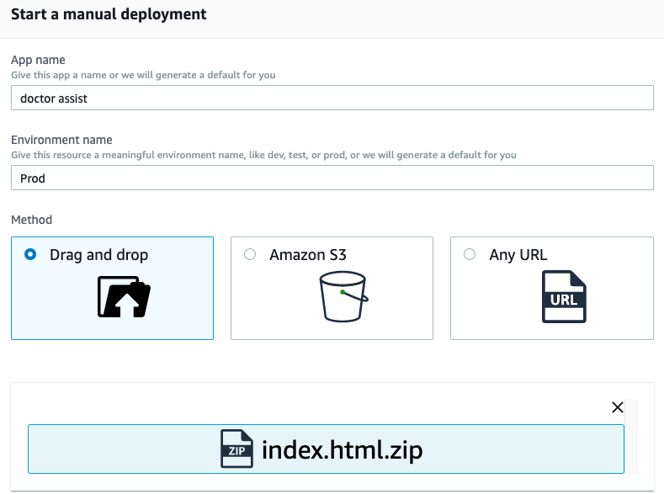
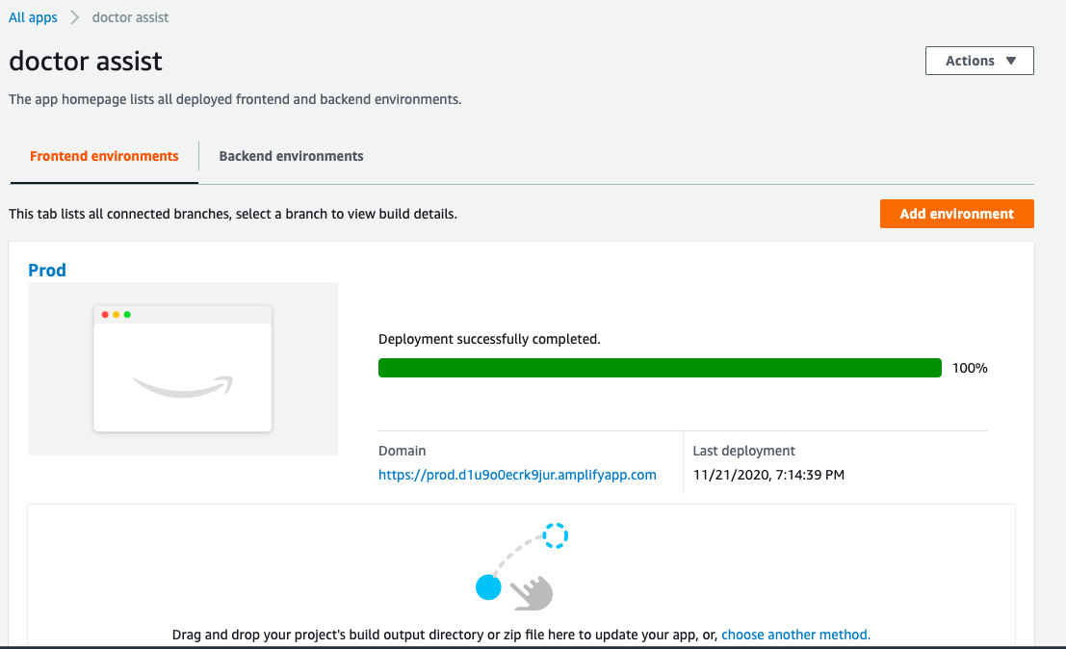
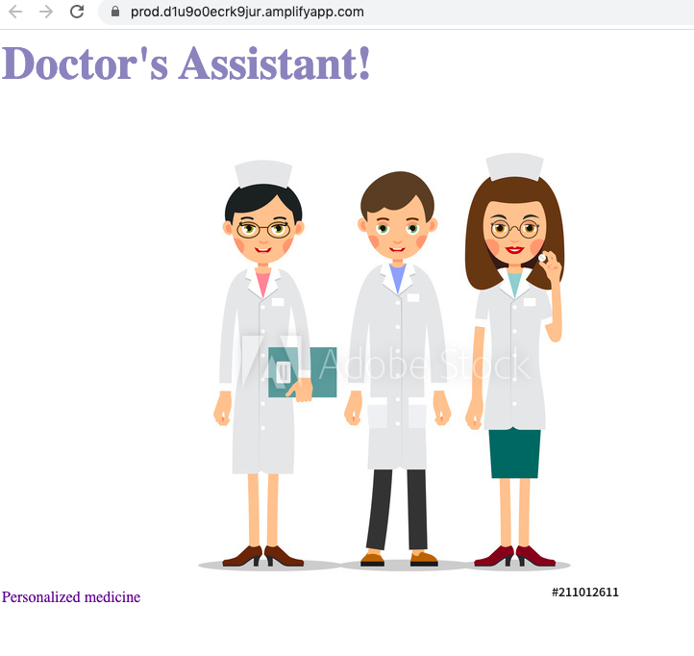

Slide 14

Summary of AWS Amplify
Level of complexity
Not complex
Time spent
8-10 minutes
Cost
A few dollars at start
Performance
Good

Slide 15
EFFICIENCY
AWS amplify
Overall Summary
COST
AWS S3
OVERALL PERFORMANCE
AWS Amplify and AWS Lightsail

